Slide 1

Implementing Deep Networks with Keras
Original material: Stefano Ghidoni
Revised: Federico Lincetto, Francesco Barbato, Pietro Zanuttigh
Notes:
today: introductory slides on keras
tomorrow: short hands-on tutorial, given a template and solution (no delivery) + LAB3 (with delivery)

Slide 2
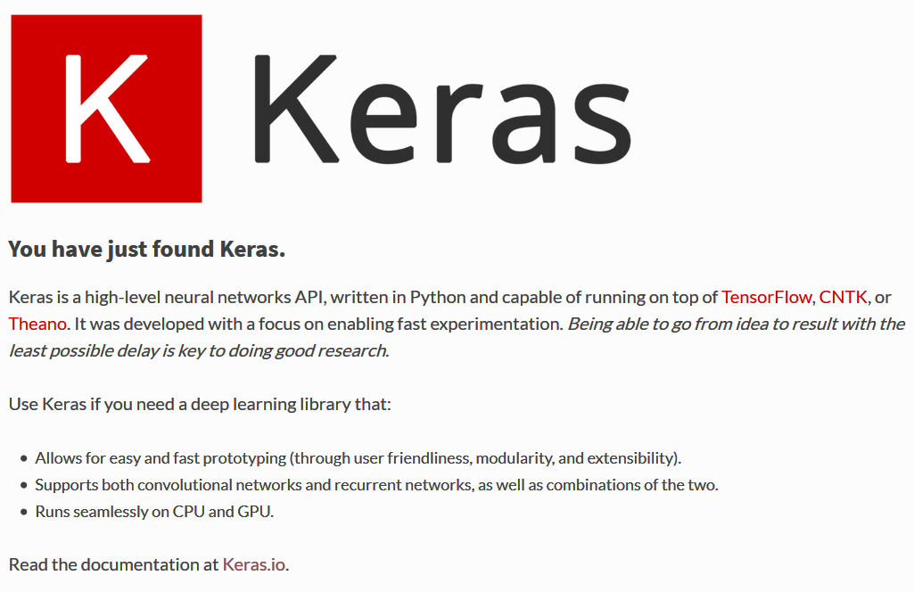
Keras
Notes:
Keras: Python library to work with neural network, acts as an interface to TensorFlow

Slide 3



Other DL Frameworks
PyTorch (most diffused, specially in research)
Tensorflow
JAX (functional programming)
Theano (deprecated)
Caffe (deprecated)
CNTK (deprecated)
…

Slide 4
Guiding Principles
User friendliness
Easy for easy things
Possible to do complex things
Modularity
Modules: neural layers, cost functions, optimizers, activation functions, regularization schemes
Extensibility
Easy to add new modules
Python-based
Interactive environment

Slide 5


Installing Keras
Comes pre-packaged with all TensorFlow2 installations
You can access it as follows:
import tensorflow as tf
tf.keras.[any keras object]
Recently, the PyTorch support has been implemented too

Slide 6
TensorFlow2 Installation
Two (main) ways of installing
anaconda (especially on Windows it is simpler)
pip (described on official website)
Anaconda installation (CPU version, simple but slow):
Assuming you already have Anaconda/Python 3
conda create -n tensorflow_env tensorflow
conda activate tensorflow_env
Anaconda installation (GPU version, requires an NVIDIA compatible GPU):
conda create -n tensorflow_gpuenv tensorflow-gpu
conda activate tensorflow_gpuenv
Could require to install (or fix issues with) CUDA and CuDNN libraries
Tensorflow and Jupyter:
Jupyter could use a different environment than the TensorFlow one

Slide 7
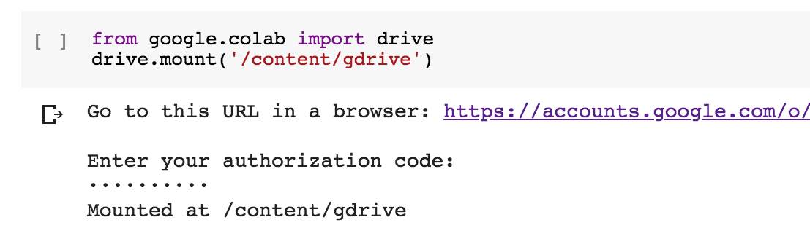

Alternative: use Google Colab
Requirements:
Google account
Internet connection
Getting started:
Go to your Google Drive and create a new notebook (New -> More -> Google Colaboratory) or upload one
Once you have opened it with Google Colaboratory , go to Edit -> Notebook Settings and select GPU
Many python libraries available, run !pip list to check
Mount your Google Drive to access files from it
Start coding!

Slide 8
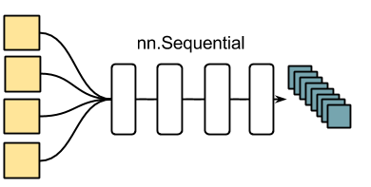
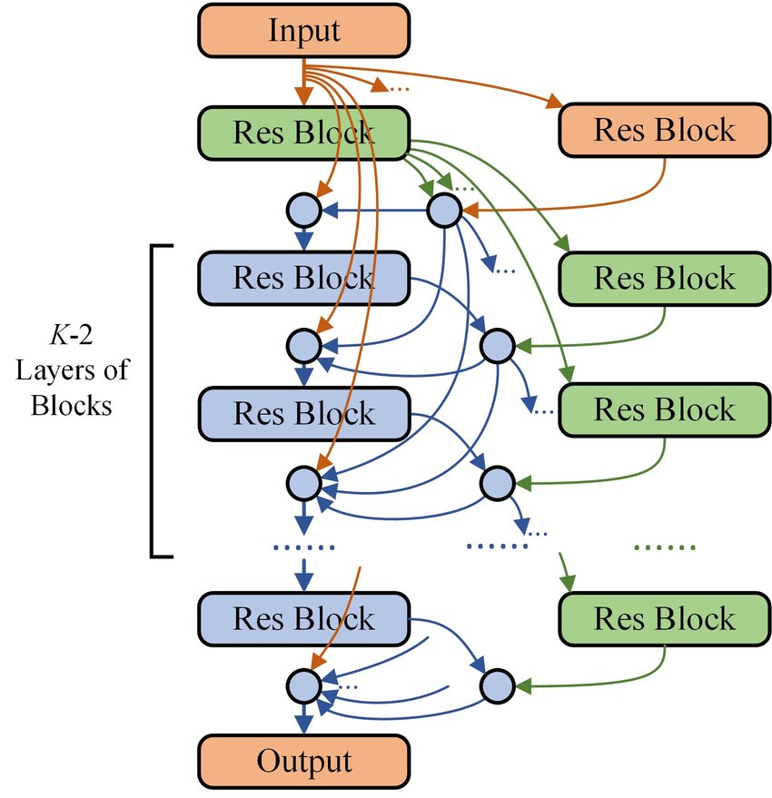
Sequential vs. Functional Models
Two ways to build Keras models: sequential and functional
The sequential API allows you to create models layer-by-layer
Each layer is connected to the previous and next
Write your neural network in a few lines of code
It does not allow you to create complex models
The functional API allows you to create models that have a lot more flexibility
In fact, you can connect each layer to any other layer
Creating complex networks becomes possible

Slide 9
The Easy Way
Instantiate a sequential model
Stack some layers
Configure/tune the learning process
Iterate on the training data
Evaluate performance
Generate predictions
Notes:
Now we are going through those steps one by one.

Slide 10
30s to Keras
Instantiate a sequential model
from tensorflow.keras import Sequential
model = Sequential()

Slide 11
30s to Keras
Stack some layers
from tensorflow.keras.layers import Dense
model.add(Dense(units=64, activation=‘relu’, input_dim=100))
model.add(Dense(units=10, activation=‘softmax’))
Add one layer after the other (order matters !)
Specify input for first layer (for the others it is the output of the previous one)

Slide 12
30s to Keras
Configure/tune the learning process
model.compile(loss=‘categorical_crossentropy’,
optimizer=‘sgd’,
metrics=[‘accuracy’])
model.compile(loss=tf.keras.losses.categorical_crossentropy,
optimizer=tf.keras.optimizers.SGD(lr=0.01,
momentum=0.9, nesterov=True))
Notice the difference between loss (used for NN optimization) and metrics
Can use pre-defined settings ('..') or manually specify optimizer parameters (…modularity and extensibility…)

Slide 13
30s to Keras
Iterate on the training data
x_train and y_train can be numpy arrays, like in scikit-learn
model.fit(x_train, y_train, epochs=5, batch_size=32)
model.train_on_batch(x_batch, y_batch)
fit: runs the whole training procedure
train_on_batch: perform a single step

Slide 14
30s to Keras
Evaluate performance
loss_and_metrics = model.evaluate(x_test, y_test, batch_size=128)

Slide 15
30s to Keras
Generate predictions
The end
Simple but limited… More advanced example with functional model in the notebook
classes = model.predict(x_test, batch_size=128)

Slide 16
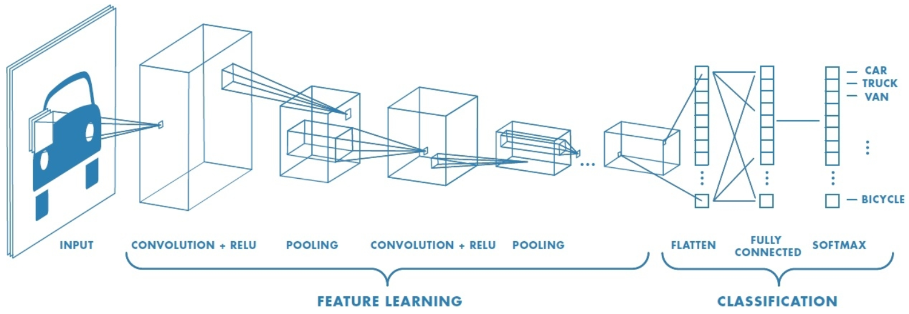
Keras: Build a CNN
Typical layers in a Convolutional Neural Network
Convolutional
Pooling
Fully connected
Activations (ReLU, Softmax, …)
Notes:
CNNs for images in many fields. Wherever you could interpret something as an image and even if you cannot what it’s important for CNNs to work is that there should be correlation among the spatial components. In that case you could benefit from using CNNs.

Slide 17
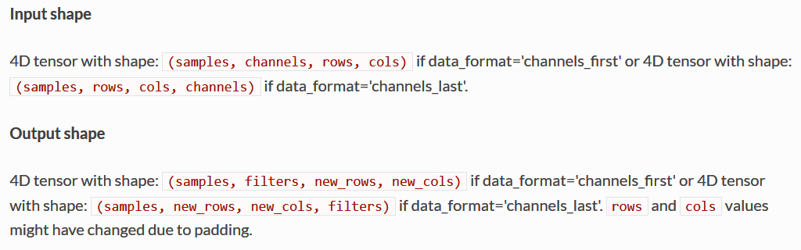
I/O: Tensors
Tensor: typed multi-dimensional array (From TensorFlow)

Slide 18
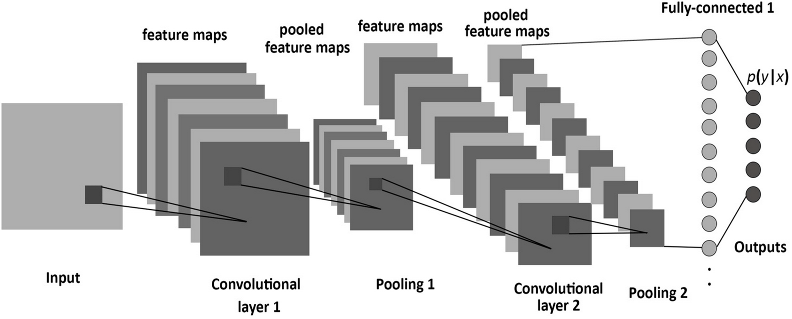

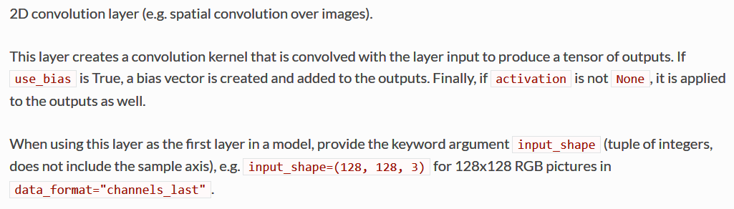
2D Convolutional Layers in Keras

Slide 19
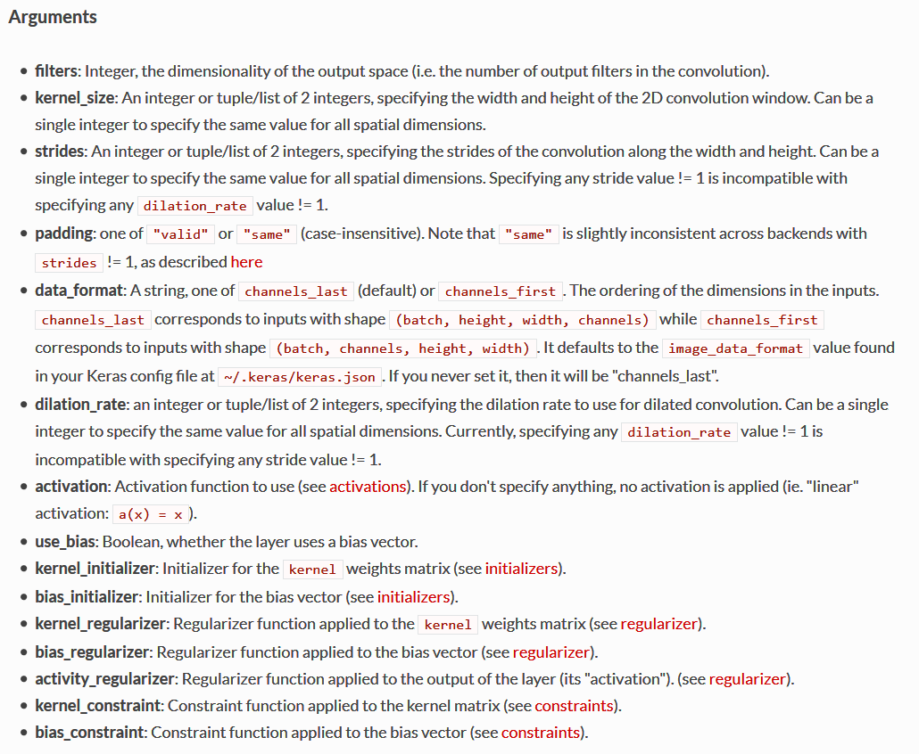
Conv2D Arguments
The argument list is huge!
Specify only the desired arguments
Rely on default values for the others

Slide 20
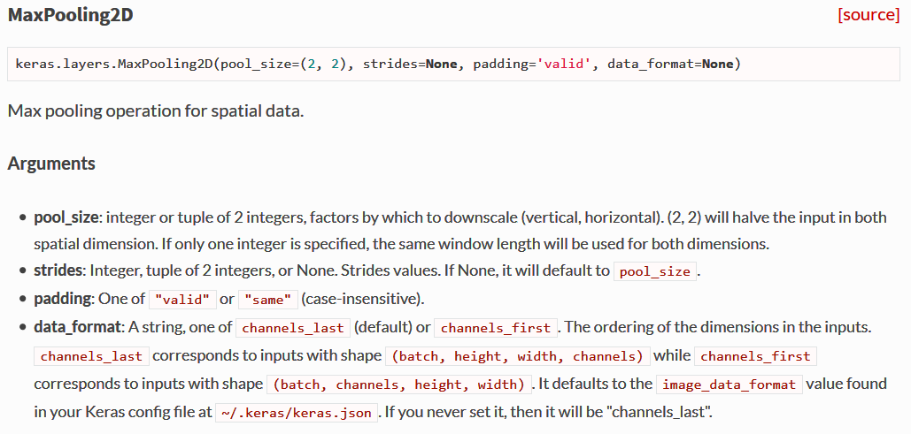
Pooling Layers

Slide 21
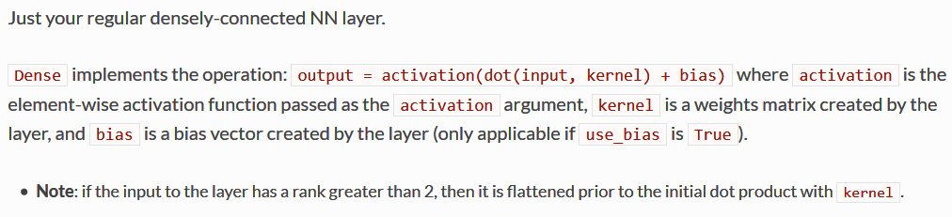
Dense (Fully Connected) Layers

Slide 22
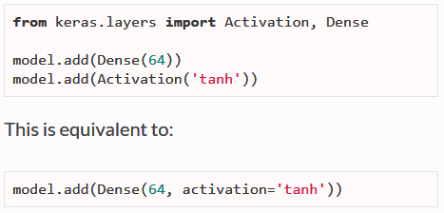
Activations and Softmax
Activations (e.g. ReLU, tanh, …)
As standalone layers
Embedded in forward layers
Softmax activation often at the end of the last fully connected layer

Slide 23
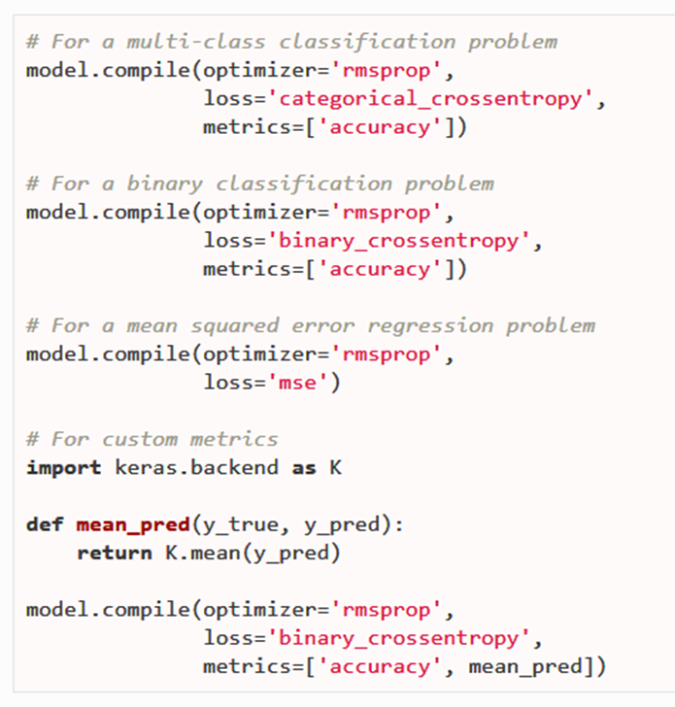
Compiling a Model
Compiling a model means configuring the learning process
A model can be compiled by providing
An optimizer
A loss function
A list of metrics
The choices depend on the considered problem
Binary classification
Multi-class classification
Regression

Slide 24
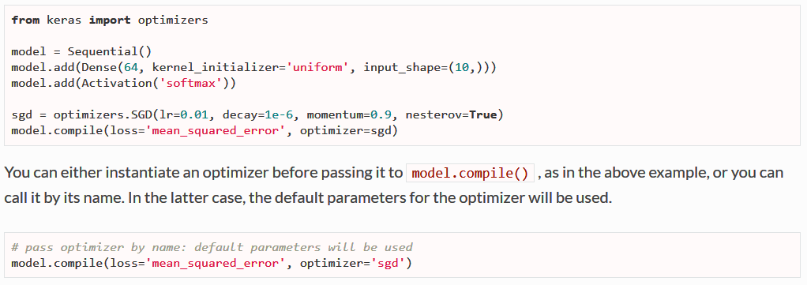
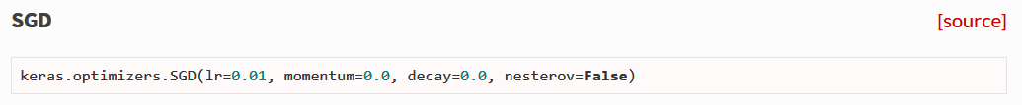
Optimizers

Slide 25
Loss Function (1)
Loss Function
a.k.a. objective function
a.k.a. optimization score function
Measures the distance between actual and desired output
Drives the training process
Depends on the task / output type
Classification vs regression

Slide 26
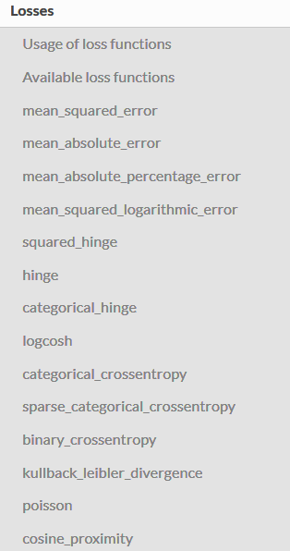
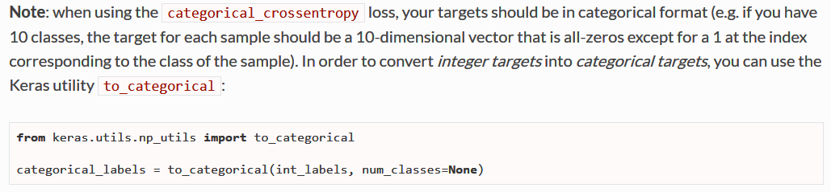
Loss Function (2)
Can be selected from a set of predefined functions, or user-defined
Good starting points
Classification: categorical/binary cross entropy
Regression: mean square error (L2)
one-hot representation

Slide 27
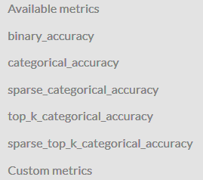
Metrics
"A metric function is similar to a loss function, except that the results from evaluating a metric are not used when training the model”

Slide 28
Resources
Getting started with Keras
https://keras.io/getting-started/sequential-model-guide/
https://blog.keras.io/keras-as-a-simplified-interface-to-tensorflow-tutorial.html
Focus on optimization algorithms
https://towardsdatascience.com/types-of-optimization-algorithms-used-in-neural-networks-and-ways-to-optimize-gradient-95ae5d39529f
Metrics
https://machinelearningmastery.com/custom-metrics-deep-learning-keras-python/
Selected MNIST example
https://yashk2810.github.io/Applying-Convolutional-Neural-Network-on-the-MNIST-dataset/
https://elitedatascience.com/keras-tutorial-deep-learning-in-python
https://github.com/keras-team/keras/blob/master/examples/mnist_cnn.py
Interactive examples of NN
GitHub - MilesCranmer/awesome-ml-demos: Curated list of interactive ML demos

